Slide 1
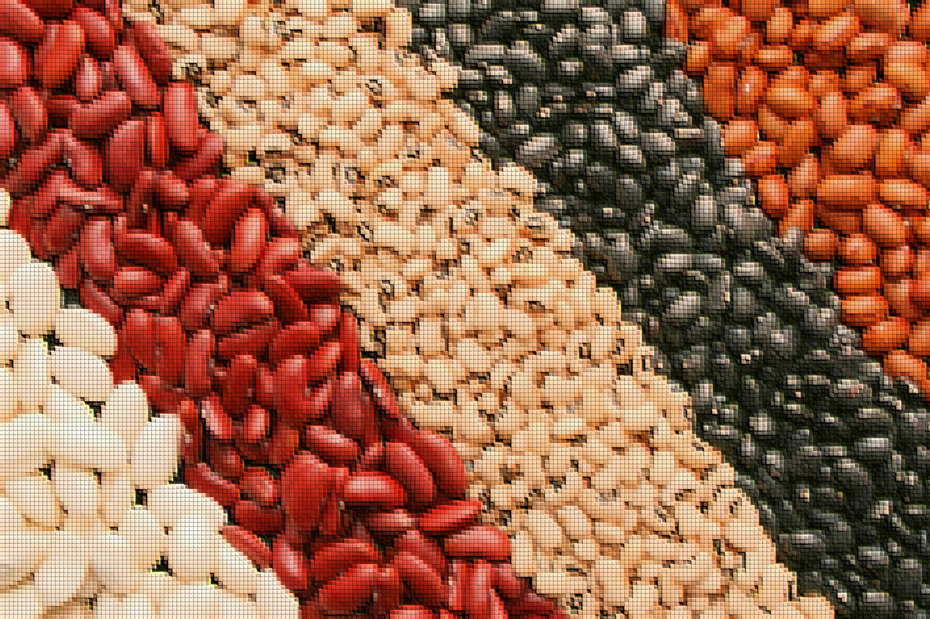

Classification of Dry Beans Using Machine Learning

Slide 2


RATIONALE
High degree of genetic diversity among different dry bean varieties. Beans are usually mixed up in same bags.
Dry bean is the most edible, most produced pulse in the world.
Cultivation with different species of dry bean results in economic losses.
Manual classification and sorting is expensive and inefficient at high production volume.
Uniform seed varieties
|
Better planting standards
|
Higher seed quality
|
Lower disease
|
Higher production yield
|
Higher market value
Similar color makes visual inspection difficult, physical features are needed.

Slide 3
PROJECT GOALS
1
Build and compare machine learning models to accurately classify dry bean varieties using physical geometric attributes captured through image processing
2
Determine the data mining technique that best discriminates among different dry bean varieties
3
Determine which physical attributes are most important for classifying dry beans

Slide 4
DATASET
13611
OBSERVATIONS
Data from images of 13,611 grains of dry beans
16
FEATURES
Physical geometric attributes of dry beans, obtained through image processing
1
TARGET VARIABLE
Multiclass nominal variable containing 7 classes of dry beans: Barbunya, Bombay, Cali, Horoz, Seker, Sira, and Dermason.

Slide 5
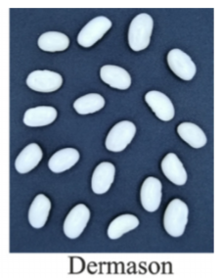
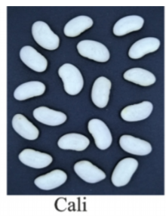
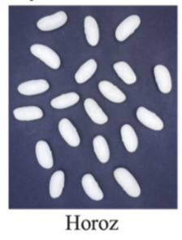
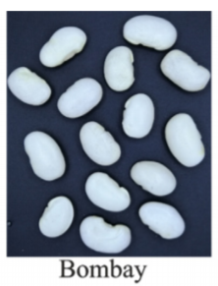

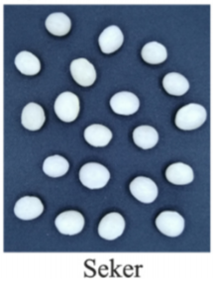
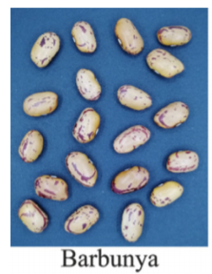
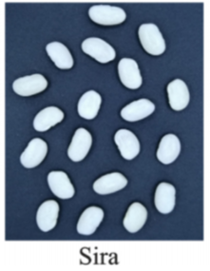
DATA - TARGET VARIABLE
Bean class
(7 categories)
Images source:
Koklu, M., & Ozkan, I. A. (2020). Multiclass classification of dry beans using computer vision and machine learning techniques. Computers and Electronics in Agriculture, 174, 105507

Slide 6
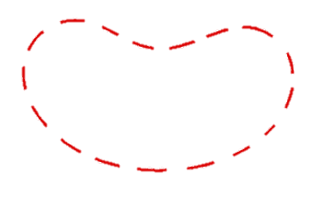
DATA - FEATURE VARIABLES
Physical Feature | Description
Area (A) | Area of bean zone in pixels
Perimeter (P) | Circumference of bean
Major Axis Length (L) | Length of longest line that can be drawn from a bean
Minor Axis Length (l) | Length of longest line drawn from a bean, perpendicular to main axis
Aspect Ratio (K) | Ratio of major and minor axis lengths (L / l)
Eccentricity (Ec) | Eccentricity of ellipse with same moments as bean region
Convex Area (C) | Number of pixels in smallest convex polygon containing bean area
Equivalent Diameter (Ed) | Diameter of the circle whose area equals bean area
Extent (Ex) | Ratio of pixels of the bean-bounding rectangle to the bean area
Solidity (S) | Ratio of pixels in convex shell to area of the bean in pixels
Roundness (R) | Calculated as: (4piA)/(P^2)
Compactness (CO) | Calculated as: Ed / L
Shape Factor 1 | Calculated as: L / A
Shape Factor 2 | Calculated as: l / A
Shape Factor 3 | Calculated as: A / (L*L*π/4)
Shape Factor 4 | Calculated as: A / (L*l*π/4)
P
A
l
L
16 physical geometric features obtained through image processing

Slide 7
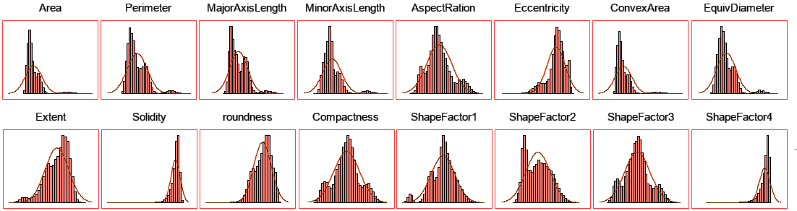
DATA - DISTRIBUTION OF FEATURES

Slide 8
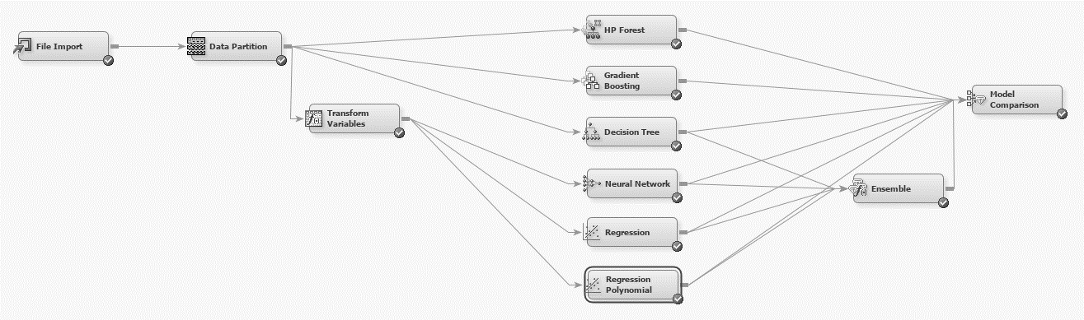
METHODOLOGY
70/30 train-validation split
7 Classification models
Models assessed by
Misclassification rate
Data transformed for Maximum normality:
Log: Area, ConvexArea, EquivDiameter, MajorAxisLength, MinorAxisLength, Perimeter
Exponential: Extent, Roundness
Square Root: AspectRation, ShapeFactor2, ShapeFactor3
Power: Eccentricity, ShapeFactor4, Solidity
Model Improvement:
2-factor interactions
Polynomial terms
Stepwise model (50 steps)

Slide 9
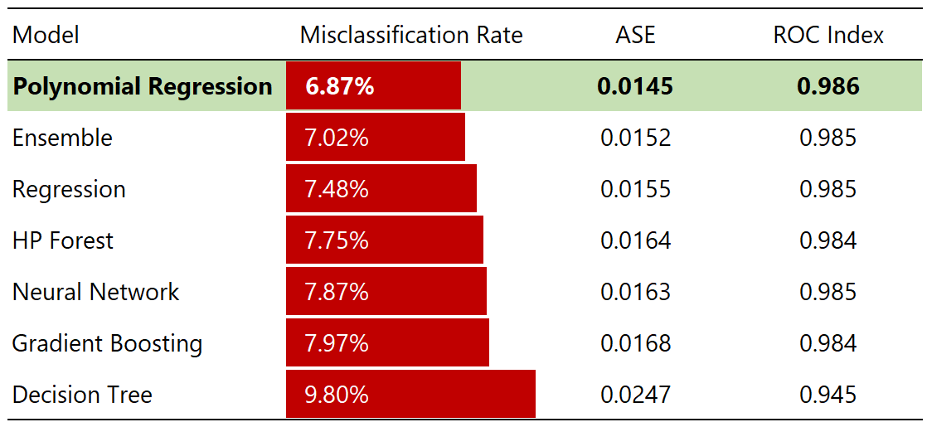
RESULTS – FIT STATISTICS OF ALL MODELS
Comparison of Model Fit Statistics on Validation Data
Lowest misclassification rate, highest accuracy
Lowest Average Squared Error (ASE)
Highest ROC Index

Slide 10
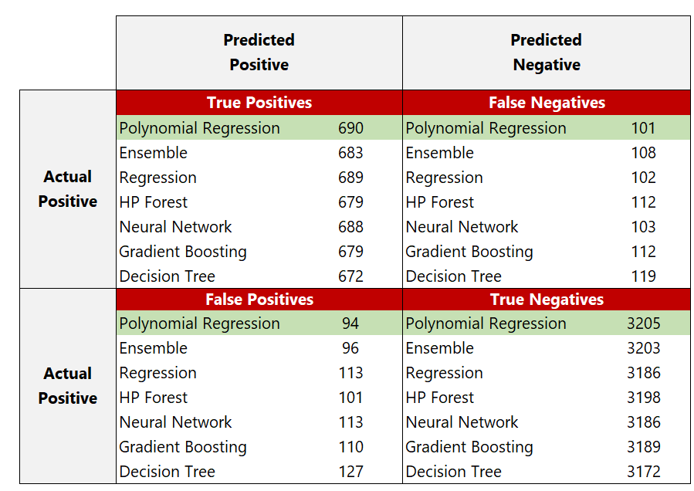
RESULTS – CONFUSION MATRIX FOR ALL MODELS
Polynomial Logistic Regression
Highest True Positive
Lowest False Negative
Highest True Negative
Lowest False Positive

Slide 11
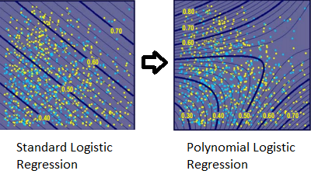
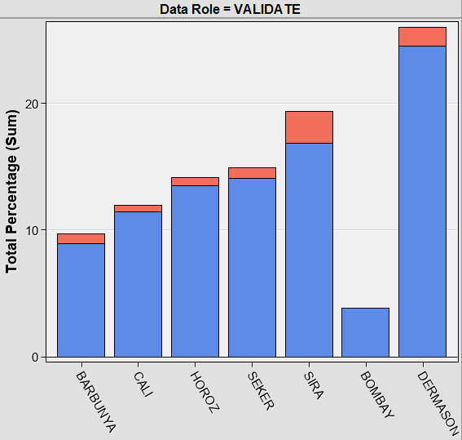
RESULTS – BEST MODEL: POLYNOMIAL LOGISTIC REGRESSION
Classification Chart by Bean Class
Legend:
Correct
Incorrect
Flexibility
Quadratic Terms
2nd Degree Polynomial
Accounts for Nonlinearities
Disproportional Classes
Bombay Bean Low Counts
No Issue with Classifying
Misclassifications Fairly Equal

Slide 12
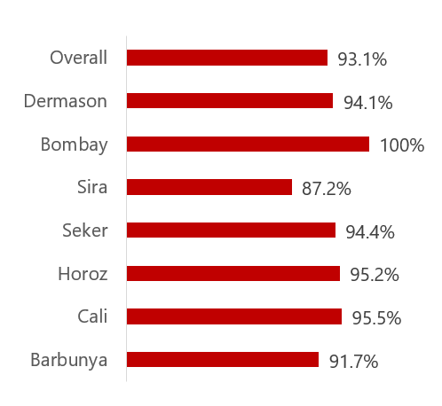
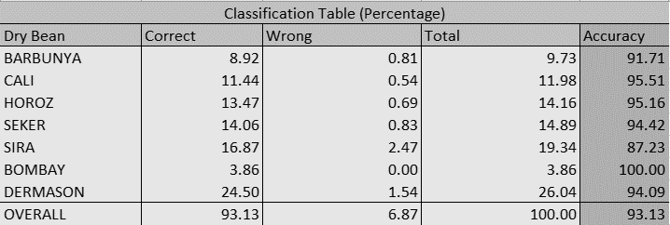
RESULTS – ACCURACY (POLYNOMIAL LOGISTIC REGRESSION)

Slide 13
RESULTS – IMPORTANT VARIABLES
Decision Tree
Decision Tree
MinorAxisLength, MajorAxisLength, Shapefactor3, Shapefactor1, Perimeter
Shapefactor3
ShapeFactor1
MinorAxisLength
Perimeter
MajorAxisLength
Polynomial Logistic Regression
ShapeFactor1, EquivDiameter, MinorAxisLength, Perimeter, Area
Compactness
Convex Area
Roundness
EquivDiameter
Area
Gradient Boosting
Compactness, Area, MajorAxisLength, Convex Area, Roundness
Polynomial Logistic Regression
Gradient Boosting

Slide 14
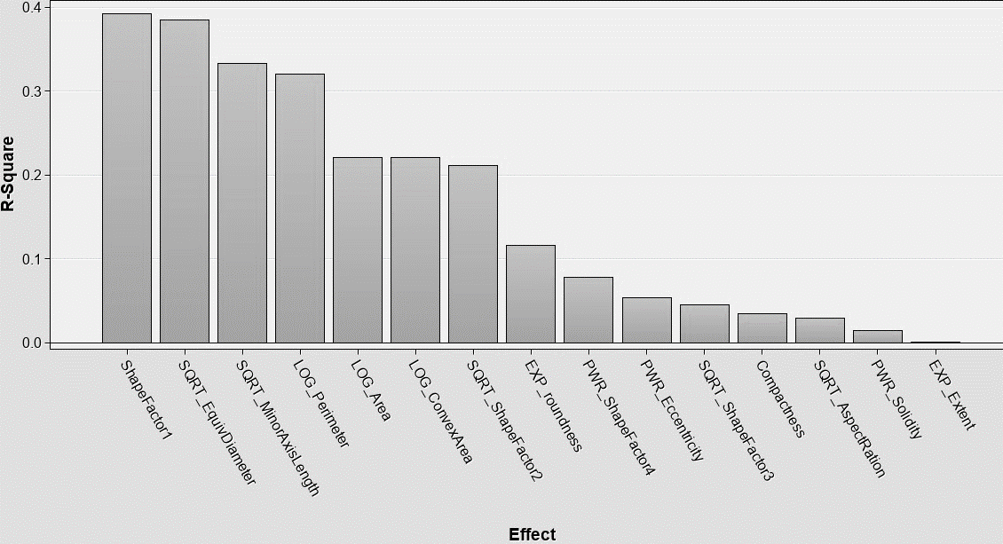
RESULTS – VARIABLE IMPORTANCE PLOT (POLYNOMIAL LOGISITIC REGRESSION)
Top 5 Physical Attributes
ShapeFactor1
EquivDiameter
MinorAxisLength
Perimeter
Area

Slide 15
CONCLUSIONS
Total of 7 Models Compared: Regression, Polynomial Regression, Neural Network, Gradient Boosting, Random Forest, Decision Tree, Ensemble (Regression, P-Regression, Decision Tree, NN)
Polynomial Logistic Regression had the best performance with the lowest misclassification rate of 6.87% and accuracy of 93.13% based on 70/30 train-test split.
Models were able to classify the fairly imbalanced and disproportional bean classes with high accuracy.
Similar accuracy rates were observed among the 7 dry bean classes. Bombay variety had the highest accuracy at 100% while the Sira bean variety had the lowest accuracy at 87.2%
Physical 2D attributes alone can be used to accurately classify dry beans. Most important variables were found to be ShapeFactor1, EquivDiameter, MinorAxisLength, Area, and Perimeter for the best performing model.
Given high classification accuracy of 93.13%, it makes sense for dry bean producers to invest in automated systems for classifying dry beans as opposed to manual sorting.

Slide 16
Thank You!
Any Questions?

